Slide 1
Machine Learning
Lecture 16: Principal Component Analysis (PCA)
Dr. Beilun Wang
Southeast University
School of Computer Science
and Engineering

Slide 2
This course
Regression (supervised)
Classification (supervised)
Feature selection
Unsupervised models
Dimension Reduction (PCA)
Clustering (K-means, GMM/EM, Hierarchical )
Learning theory
Graphical models

Slide 3
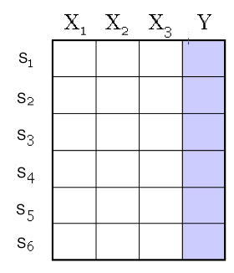
An unlabel Dataset X
a data matrix of n observations on
p variables x₁,x₂,…x_{p}
Unsupervised learning = learning from raw (unlabeled, unannotated, etc) data, as opposed to supervised data where a classification/regression label of examples is given
Data/points/instances/examples/samples/records: [ rows ]
Features/attributes/dimensions/independent variables/covariates/predictors/regressors: [ columns]

Slide 4
Today
Dimensionality Reduction (unsupervised) with Principal Components Analysis (PCA)
Review of eigenvalue, eigenvector
How to project samples into a line capturing the variation of the whole dataset Eigenvector / Eigenvalue of covariance matrix
PCA for dimension reduction
Extra: PCA examples

Slide 5
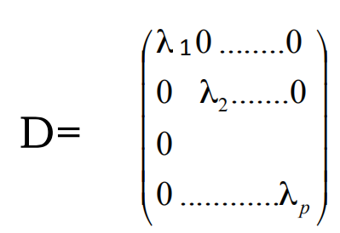

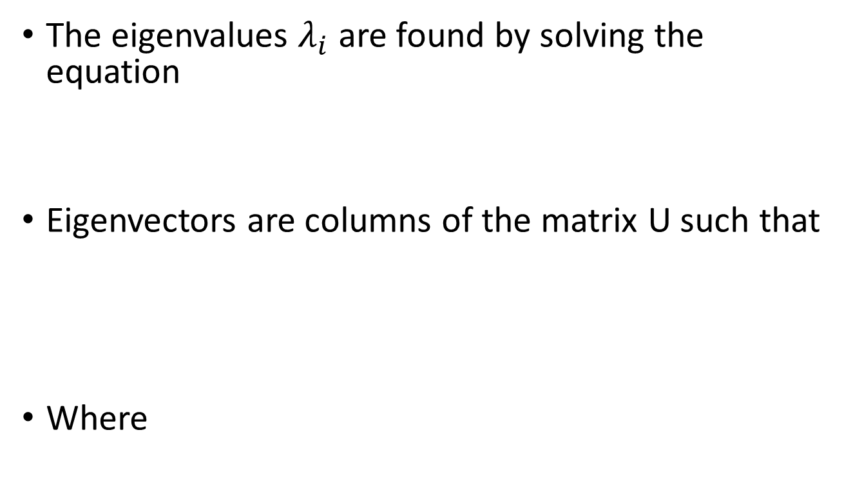


Review: Eigenvector/Eigenvalue
The eigenvalues $λ_{i}$ are found by solving the equation
Eigenvectors are columns of the matrix U such that
Where
$$Cu=λu$$
$$u≠0$$
$$\det\left(C−λI\right)=0$$
$$C=UDU^{T}$$

Slide 6




Review: Eigenvalue, e.g.
Let us take two variables with covariance c>0
$C=\left(\begin{matrix}1 & c \\ c & 1\end{matrix}\right)$ $C−λI=\left(\begin{matrix}1−λ & c \\ c & 1−λ\end{matrix}\right)$
Solving this we find $λ_{1}=1+c$
$$Cu=λu$$
$$u≠0$$
$$\det\left(C−λI\right)={(1−λ)}^{2}−C^{2}$$
$$λ_{2}=1−c<λ_{1}$$

Slide 7

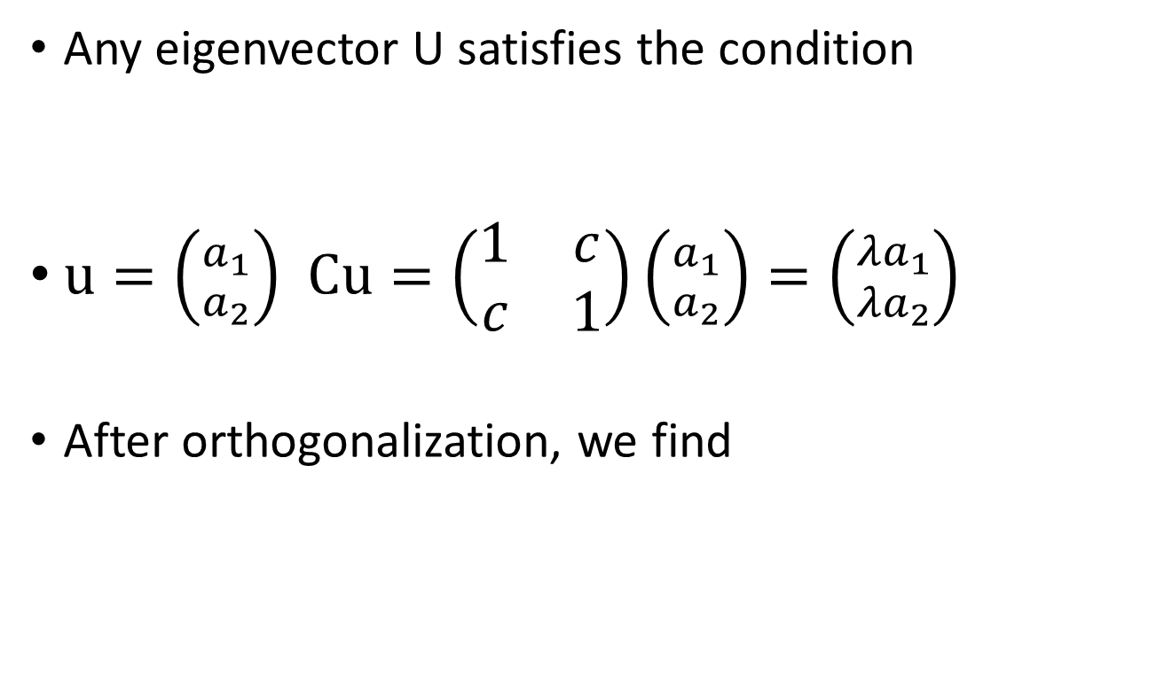

Review: Eigenvector, e.g.
Any eigenvector U satisfies the condition
$u=\left({a_{1} \atop a_{2}}\right)$ $Cu=\left(\begin{matrix}1 & c \\ c & 1\end{matrix}\right)\left({a_{1} \atop a_{2}}\right)=\left({{λa}_{1} \atop {λa}_{2}}\right)$
After orthogonalization, we find
$$Cu=λu$$
$$u_{1}=\left({\frac{1}{\sqrt{2}} \atop \frac{1}{\sqrt{2}}}\right), u_{2}=\left({\frac{1}{\sqrt{2}} \atop −\frac{1}{\sqrt{2}}}\right)$$

Slide 8
Today
Dimensionality Reduction (unsupervised) with Principal Components Analysis (PCA)
Review of eigenvalue, eigenvector
How to project samples into a line capturing the variation of the whole dataset Eigenvector / Eigenvalue of covariance matrix
PCA for dimension reduction
Extra: PCA examples

Slide 9

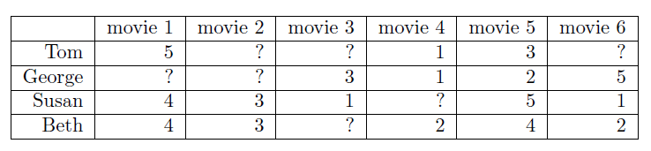
Background: Big & High-Dimensional Data
High-Dimensions = Lot of Features
Document classification
Features per document =
thousands of words/unigrams millions of bigrams, contextual information
Surveys - Netflix
480189 users x 17770 movies

Slide 10
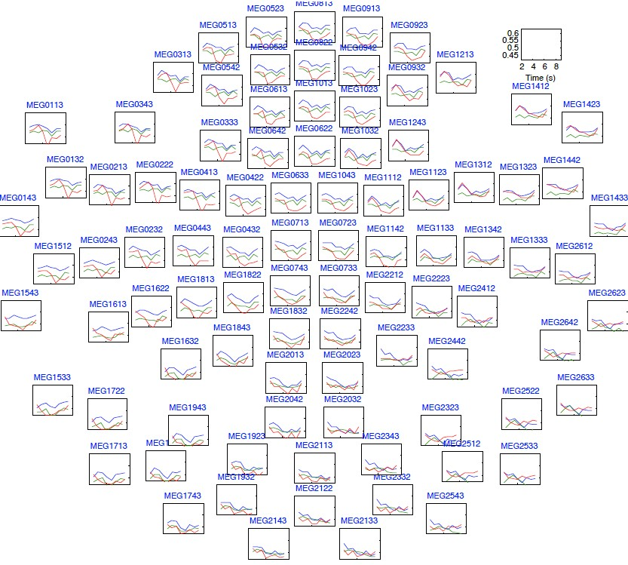
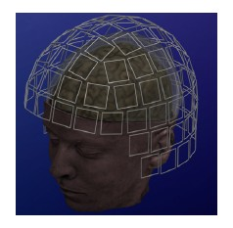



Background: Big & High-Dimensional Data
High-Dimensions = Lot of Features
MEG Brain Imaging
120 locations x 500 time points x 20 objects
Or any high-dimensional image data

Slide 11
Goal
We wish to explain/summarize the underlying variance-covariance structure of a large set of variables through a few linear combinations of these variables.

Slide 12

Trick: Rotate Coordinate Axes
Suppose we have a sample population measured on p random variables $X_{1},…,X_{p}$.
Our goal is to develop a new set of K (K<p) axes
(linear combinations of the original p axes) in the directions of greatest variability:
X₂
X₁
This could be accomplished by rotating the axes (if data is centered).

Slide 13
Algebraic Interpretation
Given n points in a p dimensional space,
for large p, how to project on to a lower-dimensional (K<p) space while preserving broad trends in the data and allowing it to be visualized?
From now we assume Data matrix is centered: we subtract the mean along each dimension, and center the original axis system at the centroid of all data points, for simplicity.

Slide 14
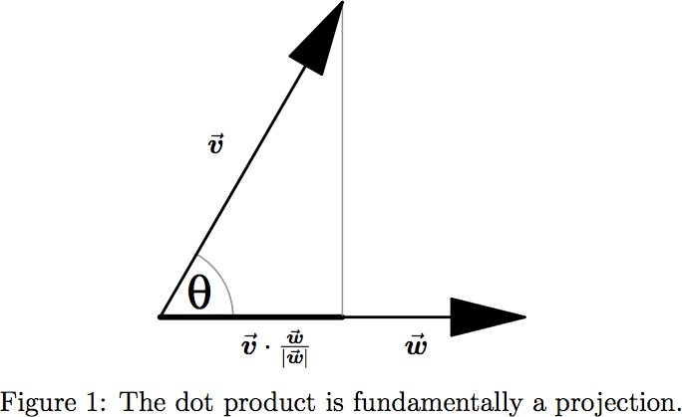
Review: Projection
x
x

Slide 15
Algebraic Interpretation – 1D
Given n points in a p dimensional space, how to project on to a 1 dimensional space?

Slide 16
Algebraic Interpretation – 1D
Formally, to find a line that maximizing the sum of squares of data samples’ projections on that line

Slide 17
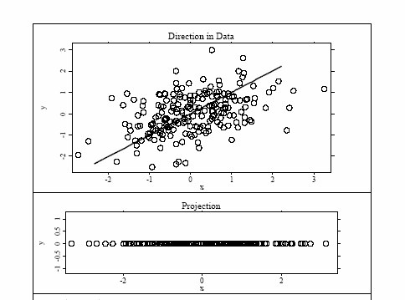
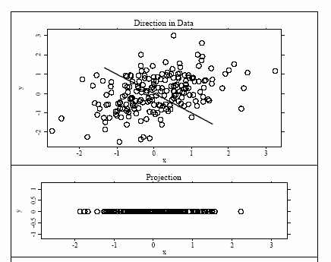
Algebraic Interpretation – 1D
Example:
Good
Better

Slide 18
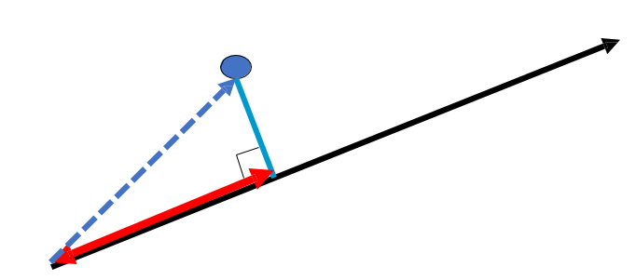
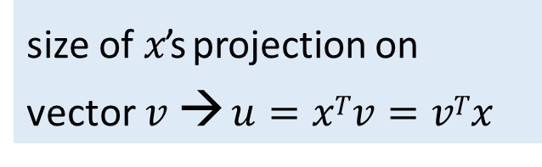

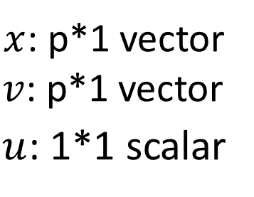



Algebraic Interpretation – 1D
Formally, to find a line (direction) that maximizing the sum of squares of data samples’ projections on that line
size of $x$’s projection on vector $v$ → $u=xTv=vTx$
$$x$$
subject to $v^{T}v=1$
$$v$$
$x$: p*1 vector
$v$: p*1 vector
$u$_{: 1*1 scalar}
$$u=xTv$$

Slide 19
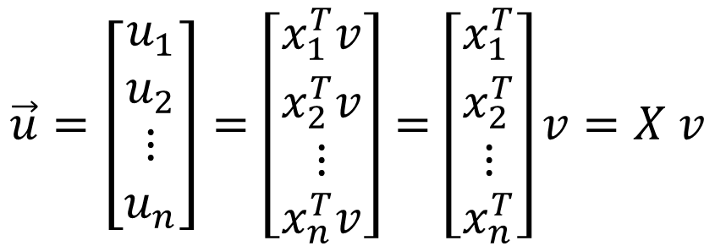
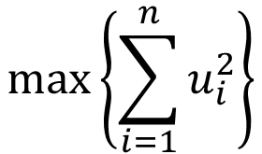


Algebraic Interpretation – 1D
$$max\left\{\sum_{i=1}^{n}{u_{i}^{2}}\right\}$$
$$\vec{u}=\left[\begin{matrix}u_{1} \\ u_{2} \\ \begin{matrix}⋮ \\ u_{n}\end{matrix}\end{matrix}\right]=\left[\begin{matrix}x_{1}^{T}v \\ x_{2}^{T}v \\ \begin{matrix}⋮ \\ x_{n}^{T}v\end{matrix}\end{matrix}\right]=\left[\begin{matrix}x_{1}^{T} \\ x_{2}^{T} \\ \begin{matrix}⋮ \\ x_{n}^{T}\end{matrix}\end{matrix}\right]v=X v$$
$$n×p$$
$$p×1$$

Slide 20
Algebraic Interpretation – 1D
How is the sum of squares of projection lengths expressed in algebraic terms?
$$\max\left(v^{T}X^{T}Xv\right), subject to v^{T}v=1$$

Slide 21

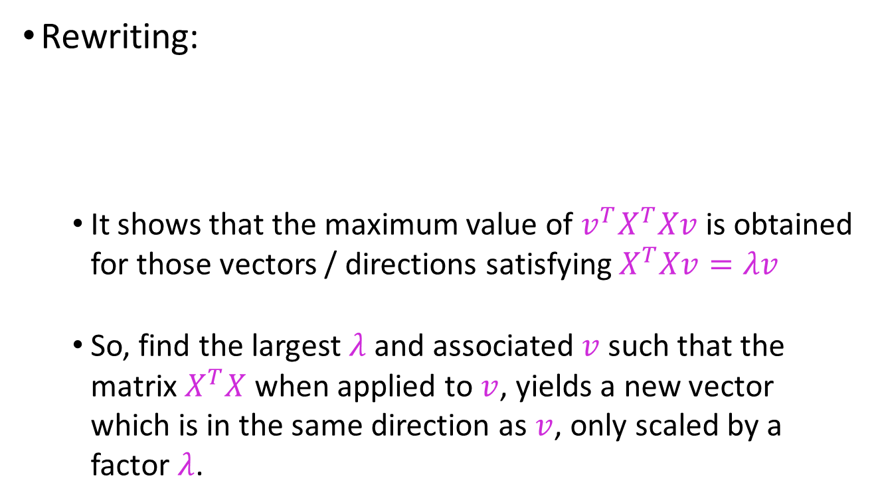

Algebraic Interpretation – 1D
Rewriting:
It shows that the maximum value of $v^{T}X^{T}Xv$ is obtained for those vectors / directions satisfying $X^{T}Xv=λv$
So, find the largest $λ$ and associated $v$ such that the matrix $X^{T}X$ when applied to $v$, yields a new vector which is in the same direction as $v$, only scaled by a factor $λ$.
$$v^{T}X^{T}Xv=λ=λv^{T}v=v^{T}(λv)$$
$$v^{T}{(X}^{T}Xv−λv)=0$$

Slide 22

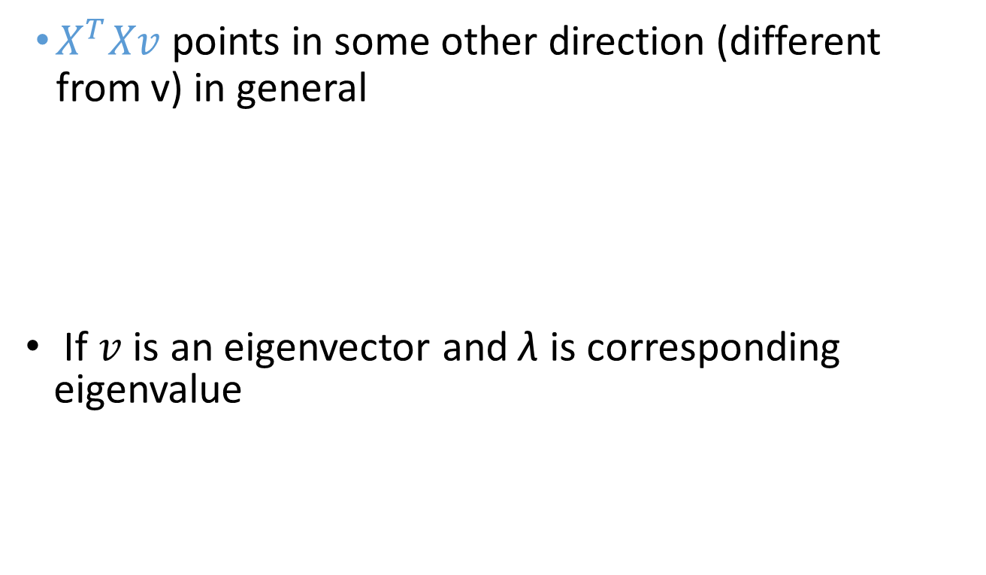



Algebraic Interpretation – 1D
$X^{T}Xv$ points in some other direction (different from v) in general
If $v$ is an eigenvector and λ is corresponding eigenvalue
$$X^{T}Xv$$
$$v$$
$$X^{T}Xv=λv$$
$$v$$

Slide 23

Algebraic Interpretation – beyond 1D
For matrices of the form (symmetric) $X^{T}X$
All eigenvalues are non-negative
λ_{1,}…,λ_{p} are the eigenvalues, ordering from large to small
i.e. Ordered by the PC’s importance

Slide 24

PCA Eigenvectors ➔ Principal Components
$$λ_{1}≥λ_{2}≥λ_{3}≥…≥λ_{p}$$
5
2nd Principal Component, v₂
1st Principal Component, v₁
4
3
2
4.0
4.5
5.0
5.5
6.0

Slide 25
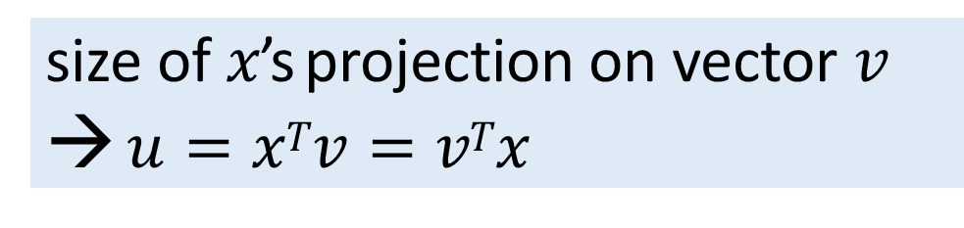

PCA (k=1): How the sum of squares of projection lengths relates to Variance?
size of $x$’s projection on vector $v$
→ $u=xTv=vTx$
In a new coordinate system with $v$ as axis, $u$ is the position of sample $x$ on this axis

Slide 26



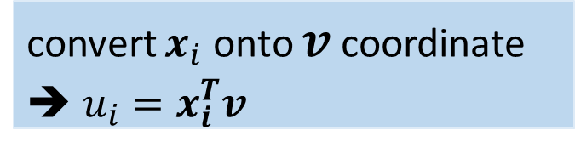

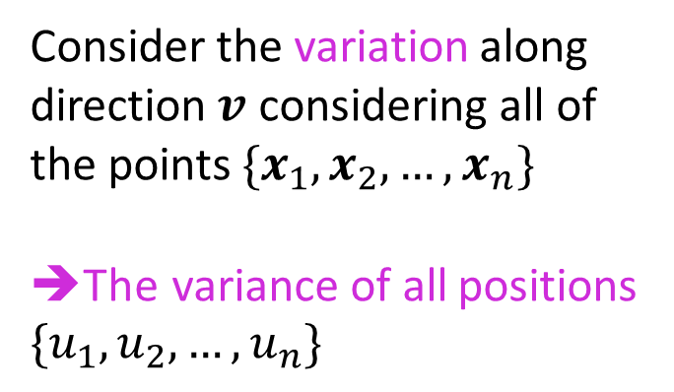


PCA (k=1): How the sum of squares of projection lengths relates to Variance?
Consider the variation along direction $v$ considering all of the points $\{x_{1},x_{2},…,x_{n}\}$
➔The variance of all positions
$$\{u_{1},u_{2},…,u_{n}\}$$
$$x_{2}$$
$$v$$
$$\vec{x_{i}}$$
$$x_{2}$$
$$u_{i}$$
convert $x_{i}$ onto $v$ coordinate
➔ $u_{i}=x_{i}^{T}v$

Slide 27


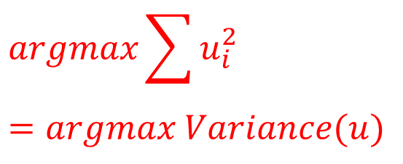

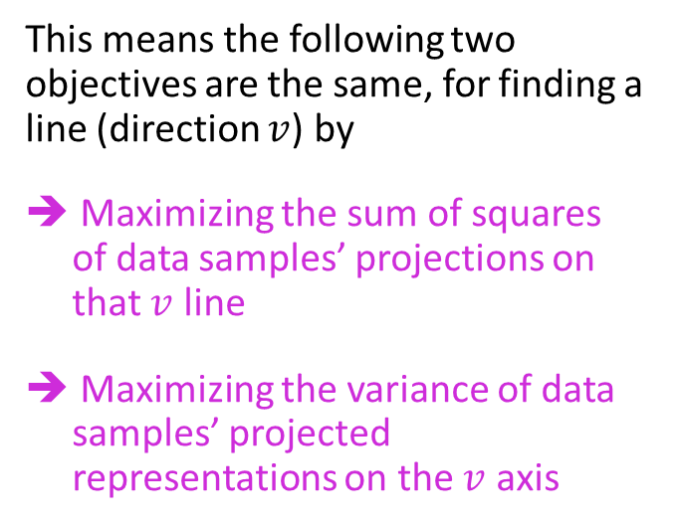





How the sum of squares of projection lengths relates to Variance?
Assuming centered data matrix
This means the following two objectives are the same, for finding a line (direction $v$) by
➔ Maximizing the sum of squares of data samples’ projections on that $v$ line
➔ Maximizing the variance of data samples’ projected representations on the $v$ axis
$$argmax\sum{u_{i}^{2}}$$
$$=argmax Variance(u)$$
$$x_{2}$$
$$v$$
$$v$$
$$v$$
$$\vec{x_{i}}$$
$$u_{i}$$
$$x_{1}$$

Slide 28
Today
Dimensionality Reduction (unsupervised) with Principal Components Analysis (PCA)
Review of eigenvalue, eigenvector
How to project samples into a line capturing the variation of the whole dataset Eigenvector / Eigenvalue of covariance matrix
PCA for dimension reduction
Extra: PCA examples

Slide 29
Applications
Uses:
Data Visualization
Data Reduction
Data Classification
Trend Analysis
Factor Analysis
Noise Reduction
Examples:
How many unique “sub-sets” are in the sample?
How are they similar / different?
What are the underlying factors that influence the samples?
How to best present what is “interesting”?
Which “sub-set” does this new sample rightfully belong?
…….

Slide 30
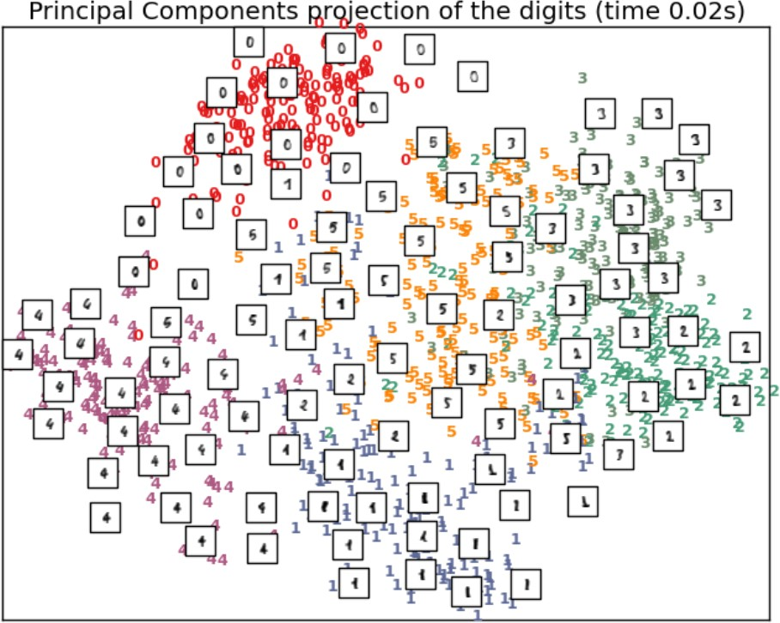
e.g. the new reduced representation is easier to visualize and interpret
e.g. From scikit learn

Slide 31
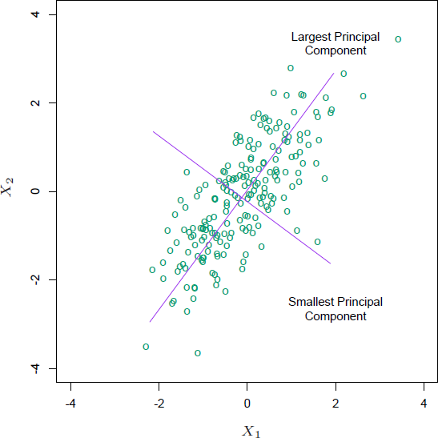
Interpretation of PCA
From p original coordinates: x₁,x₂,...,x_{p}:
Produce k new coordinates : v₁,v₂,...,v_{k}:
When p=2
v₁ = a₁₁x₁ + a₁₂x₂ + ... + a_{1p}x_{p} v₂ = a₂₁x₁ + a₂₂x₂ + ... + a_{2p}x_{p}
…

Slide 32
Interpretation of PCA
v_{k}'s are Principal Components
v_{k} are uncorrelated (orthogonal) from each other
v₁ explains as much as possible of original variance in data set
v₂ explains as much as possible of remaining variance etc.
v_{k} : k^{th} PC retains the k^{th} greatest fraction of the variation in the samples

Slide 33
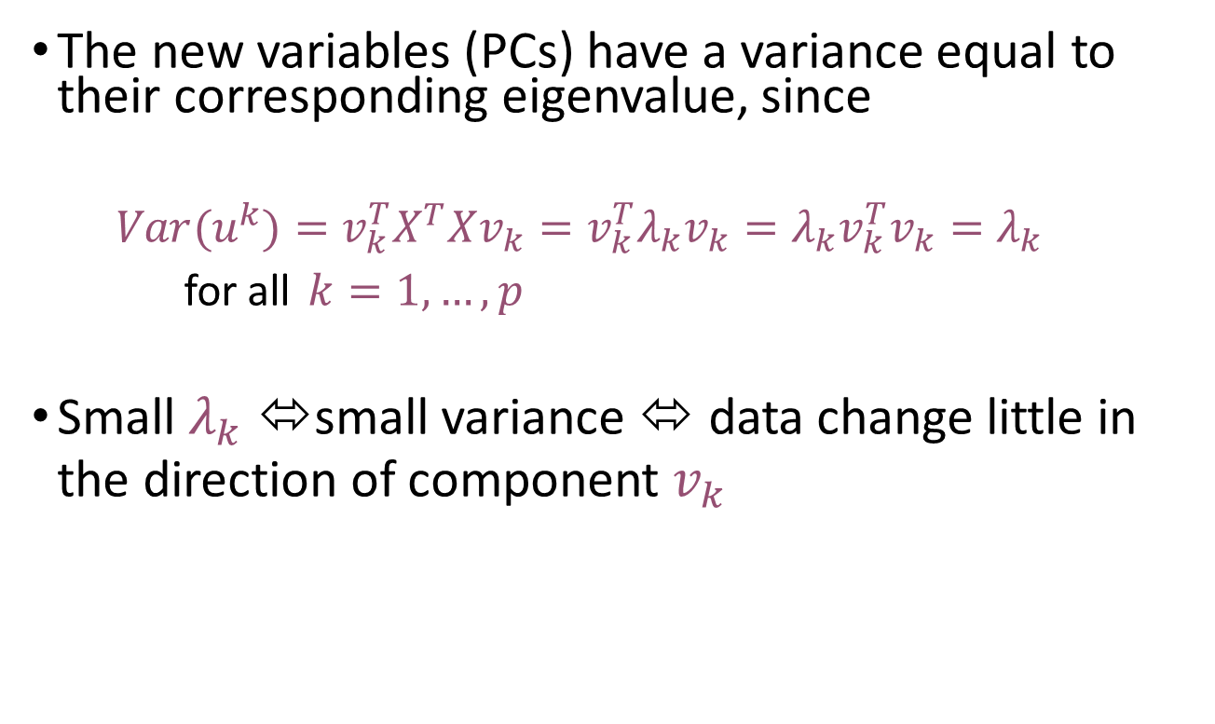
Interpretation of PCA
The new variables (PCs) have a variance equal to their corresponding eigenvalue, since
$$Var(u^{k})=v_{k}^{T}X^{T}Xv_{k}=v_{k}^{T}λ_{k}v_{k}=λ_{k}v_{k}^{T}v_{k}=λ_{k}$$
for all $k=1,…,p$
Small $λ_{k}$⬄ small variance ⬄ data change little in the direction of component $v_{k}$
PCA is useful for finding new, more informative, uncorrelated features; it reduces dimensionality by rejecting low variance features

Slide 34
PCA Summary until now
Rotates multivariate dataset into a new configuration which is easier to interpret
PCA is useful for finding new, more informative, uncorrelated features; it reduces dimensionality by rejecting low variance features
PCA compresses (i.e. perform projection ) the data points by only using the top few eigenvectors.
This corresponds to choosing a “linear subspace” represent points on a line, plane, or “hyper-plane”

Slide 35
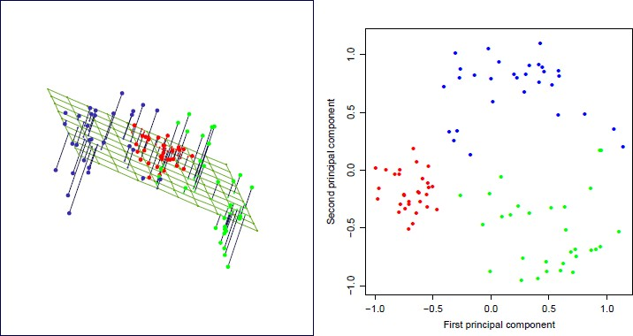


PCA for dimension reduction e.g. p=3 ➔ (pick top k=2 PCs)
$$k=2$$
$$p=3$$
corresponds to choosing a
“2D linear plane”

Slide 36
How many components to keep?
I. Variance: Enough PCs to have a cumulative variance explained by the PCs that is >50-70%
II. Scree plot: represents the ability of PCs to explain the variation in data, e.g. keep PCs with eigenvalues >1

Slide 37
e.g. check percentage of kept variance
25
The relative variance explained by each PC is given by λ_{i}/sum_{k}(λ_{k})
20
Variance (%)
15
10
5
0
PC1 PC2 PC3 PC4 PC5 PC6 PC7 PC8 PC9 PC10
You do lose some information, but if the eigenvalues are small, you donʼt lose much
p dimensions in original data
Calculate p eigenvectors and eigenvalues
choose only the first k eigenvectors, by keep enough variance
final projected data set has only k dimensions

Slide 38
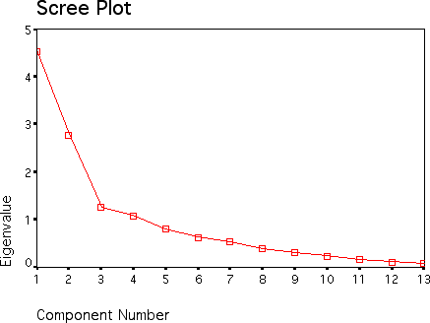


e.g. check eigenvalue
$$k=3$$
$$p=13$$

Slide 39



Limitations of PCA
PCA is not effective for some datasets.
For example, if the data is a set of strings
$(1,0,0,0,…), (0,1,0,0…),…,(0,0,0,…,1)$then the eigenvalues do not fall off as PCA requires.
$$\left[\begin{matrix}1 & 0 & 0 \\ 0 & 1 & 0 \\ 0 & 0 & 1\end{matrix}\right]$$
$$eigenvalue=[1,1,1]$$

Slide 40


Limitations of PCA
The direction of maximum variance is not always good for classification (Example 1)
For this case:
Ideal for capturing global variance
Not ideal for discrimination
First PC

Slide 41
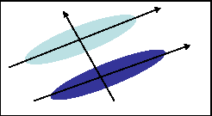
Limitations of PCA
PCA may not find the best directions for discriminating between two classes. (Example 2)
Example:
suppose the two classes have 2D Gaussian densities as ellipsoids.
1st eigenvector is best for representing the probabilities / overall data trend
2nd eigenvector is best for discrimination.

Slide 42
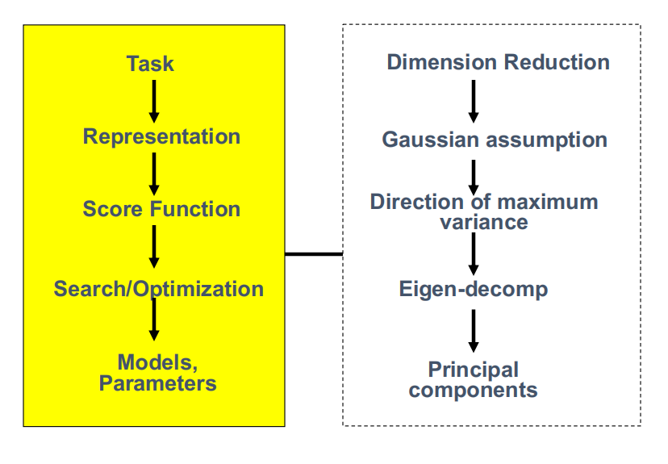
Principal Component Analysis

Slide 43
References
Hastie, Trevor, et al. The elements of statistical learning. Vol. 2. No.1 New York: Springer, 2009.
Dr. S. Narasimhan’s PCA lectures
Prof. Derek Hoiem’s eigenface lecture

Slide 44
Today
Dimensionality Reduction (unsupervised) with Principal Components Analysis (PCA)
Review of eigenvalue, eigenvector
How to project samples into a line capturing the variation of the whole dataset Eigenvector / Eigenvalue of covariance matrix
PCA for dimension reduction
Extra: PCA examples

Slide 45
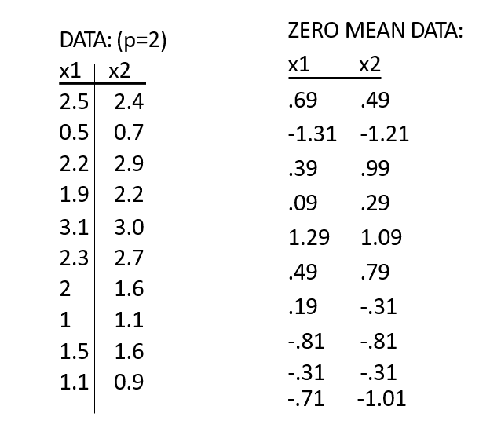
Example: A 2D Numerical example
Step 1: subtract the mean from each of the data dimensions.
It makes variance and covariance calculation easier by simplifying their equations.
The variance and covariance values are not affected by the mean value.

Slide 46

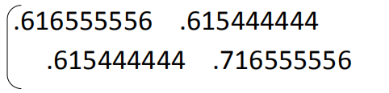


Example: A 2D Numerical example
Step 2: calculate the covariance matrix
since the non-diagonal elements in this covariance matrix are positive, we should expect that the x1 and x2 variable increase together.

Slide 47
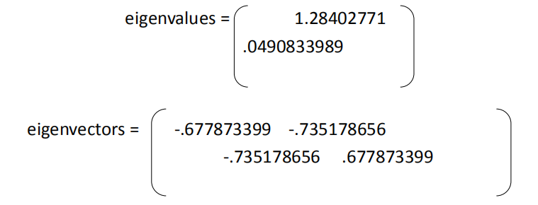





Example: A 2D Numerical example
Step 3: calculate the eigenvectors and eigenvalues of the covariance matrix

Slide 48
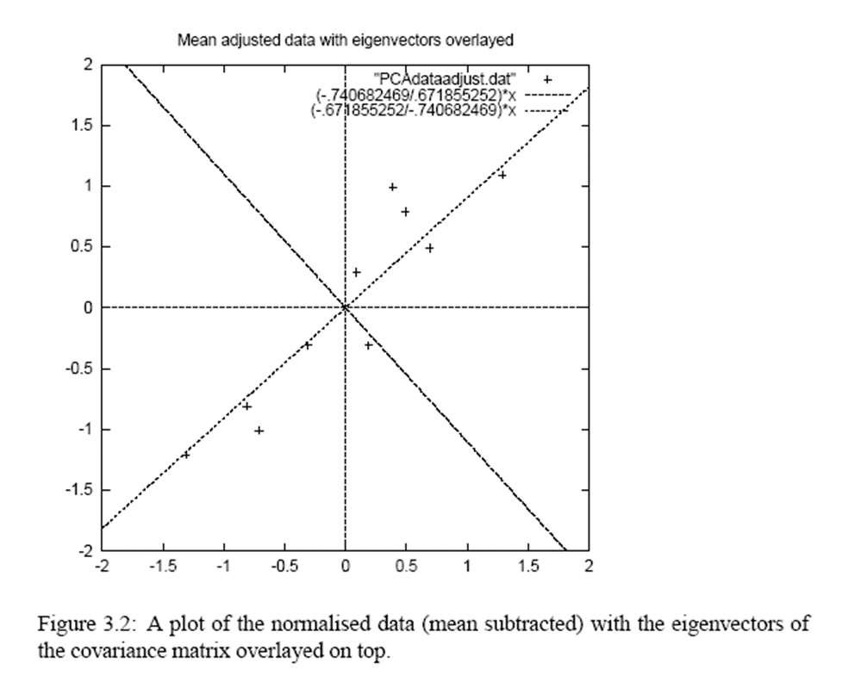
Example: A 2D Numerical example
eigenvectors are plotted as diagonal dotted lines on the plot.
Note they are perpendicular to each other.
Note one of the eigenvectors goes through the middle of the points

Slide 49

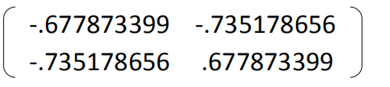
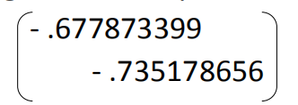

Example: A 2D Numerical example
Step 4: reduce dimensionality and form feature vector
Feature Vector =
We can either form a feature vector with both of the eigenvectors:
or, we can choose to leave out the smaller, less significant component and only have a single column:

Slide 50
Example: A 2D Numerical example
Step 5: derive the new data
FinalData = RowFeatureVector x RowZeroMeanData
RowFeatureVector is the matrix with the eigenvectors in the columns transposed so that the eigenvectors are now in the rows, with the most significant eigenvector at the top
RowZeroMeanData is the mean-adjusted data transposed, ie. the data items are in each column, with each row holding a separate dimension.

Slide 51
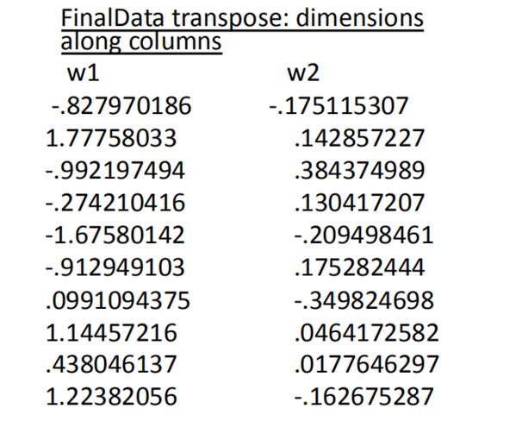
Example: A 2D Numerical example

Slide 52
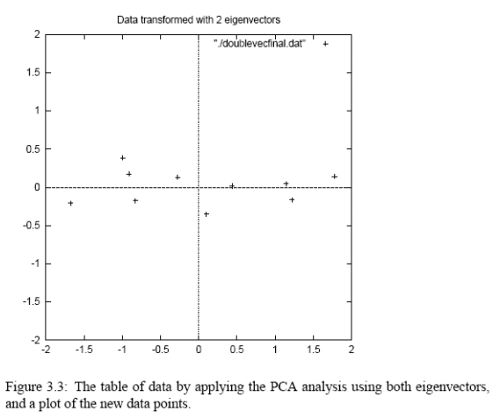
Example: A 2D Numerical example

Slide 53
Example: A 2D Numerical example
Reconstruction of original Data
If we reduced the dimensionality, obviously, when reconstructing the data we would lose those dimensions we chose to discard.
In our example let us assume that we considered only the w1 dimension…

Slide 54
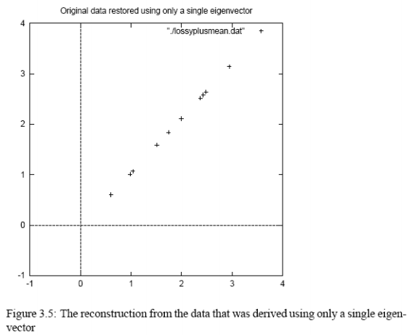
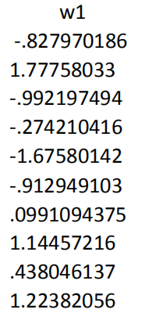
Example: A 2D Numerical example

